Slide 1
Introduction to Circulatory System

Slide 2
By the end of this Smart Lesson you should be able to:
1. | Explain why we need a circulatory system.
2. | Describe the function of the blood vessels.
3. | Explain what the main function of the blood is.
4. | Describe the function of the heart.

Slide 3
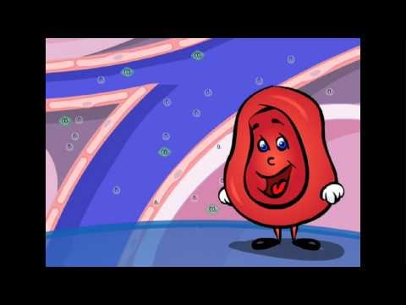

Slide 4

Did you know that a decreased blood flow is why people sometimes faint?
It is caused by a decreased blood flow to the brain, causing a sudden loss of consciousness due to the lack of oxygen present. Crazy right?!
Blood plays an essential role in transporting oxygen throughout your body.

Slide 5
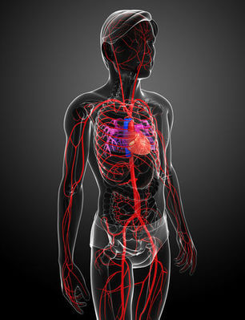
The circulatory system acts to connect all the systems within the body.
It is comprised of the heart, blood vessels and blood.
It transports oxygen from the respiratory system and products of the digestive system to cells requiring energy. It also removes waste products from cells and delivers them to the lungs and kidneys to be excreted.

Slide 6


Slide 7
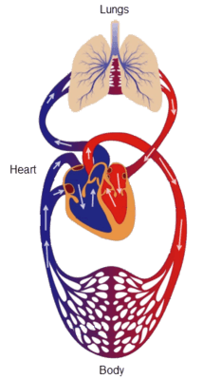
The largest part of the circulatory system are the blood vessels.
Blood vessels are like highways, linking all the different parts of your body together.
They carry blood throughout your body. The three main blood vessels you will learn about are:
1. | Arteries
2. | Veins
3. | Capillaries

Slide 8
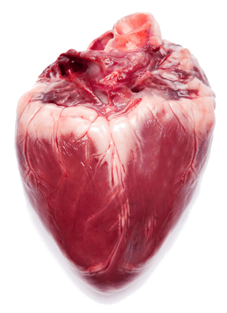
The Heart
The heart is like a big motor, powering the movement of traffic along the blood vessel highways.
It is made of muscle and pumps continuously (yes, even when you sleep) to keep your blood moving.

Slide 9
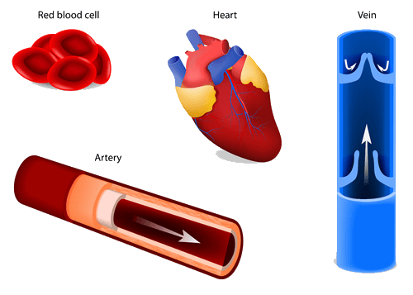
The traffic on the highways of the circulatory system is the blood.
The blood is a fluid that contains many blood cells which carry food, oxygen and nutrients to where they're needed in the body. It also takes waste products like carbon dioxide away from the organs that produce them.

